Slide 1
TEETH DETECTION & DENTAL PROBLEM CLASSIFICATION IN PANORAMIC X-RAY IMAGES USING DEEP LEARNING AND IMAGE PROCESSING TECHNIQUES
NAMITHA C
Roll No : 36
Product Owner : Mr. MOHAMMAD JABIR C

Slide 2
TABLE OF CONTENTS
Introduction
Modules
Methodology
Data Flow Diagram
Table Design
Developing Environment
Future Enhancement
User stories
Product plan
Project backlog
Sprint backlog plans
Sprint actual
Screenshot

Slide 3
INTRODUCTION
Deep convolutional neural networks, have gained a lot popularity in medical research due to their impressive results in detection, prediction and classification. Panoramic X-ray is a 2 dimensional dental X-ray that captures the entire mouth in a single image including the teeth ,upper and lower jaws, surrounding structures and tissues. Analysis of panoramic dental radiographies help specialists observe problems in poor visibility areas, inside the buccal cavity or in hard to reach areas. However, poor image quality or fatigue can cause the diagnosis to vary, which can ultimately hinder the treatment. In this paper we propose a novel approach of automatic teeth detection and dental problem prediction using panoramic X-Ray images which can aid the medical staff in making decisions regarding the correct diagnosis. The image processing techniques include Semantic segmentation is process of assigning a label to every pixel in the image for complete scene understanding, the algorithm should figure out the object and it’s pixels. The conversion of colour image into grey scale image is converting the RGB values into grey scale value. CNN extract the feature of image and convert it into lower dimension without loosing its characteristics.

Slide 4
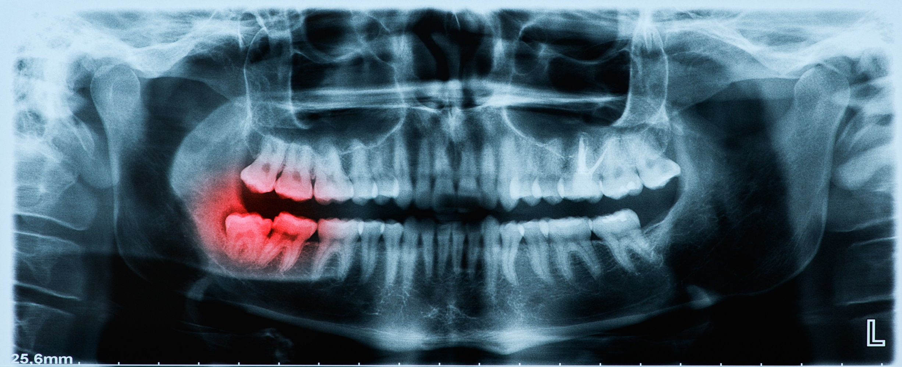
Panoramic X-ray image

Slide 5
CNN Algorithm
There are multiple convolutional layers extracting features from the image and finally the output layer.
CNN extracts the feature of image and convert it into lower dimensions without loosing its characteristics.
The role of cnn is to reduce the images into a form which is easier to process,without losing features which are critical for getting good prediction.
Each input layer is connected to the next hidden layer.
The output obtained is compared with dataset and then predict the result.

Slide 6
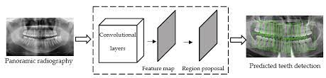
CNN is mainly used in image recognition, object detection and segmentation.

Slide 7
MODULES
ADMIN
Login
View users
Add tips
View feedback
Add and manage dataset
Add hospitals

Slide 8
2. USER
Register
Login
View tips
Feedback
Upload X-Ray image
Upload X-Ray image and predict problem
View nearest hospital

Slide 9
Methodology
Application have 2 modules,Admin and User
In admin module admin can login ,view users who were registered
Admin can add certain tips for dental care.
View Feedback from users and add hospital details locality and locations for better treatment.
In User module user can login ,view tips from admin and can provide feedbacks to admin about the provided facilities
Upload the x-ray images and see the prediction.
View the hospital in their location.

Slide 10
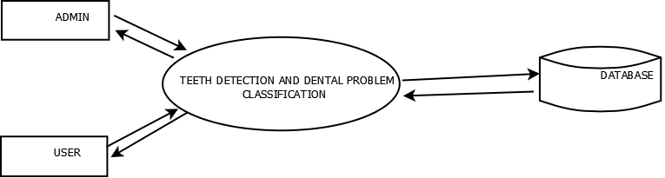
DATA FLOW DIAGRAM Level- 0

Slide 11
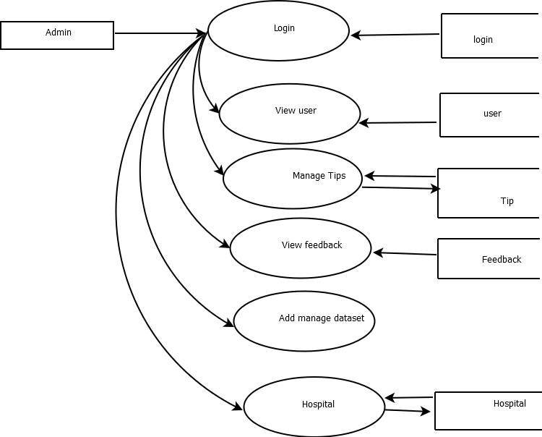

Slide 12
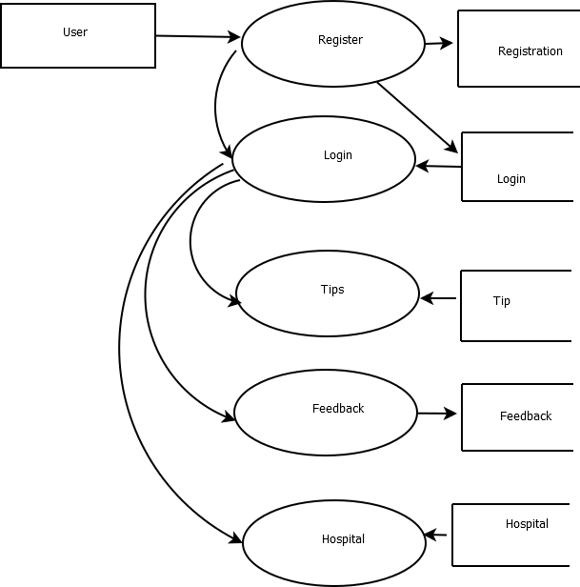

Slide 13
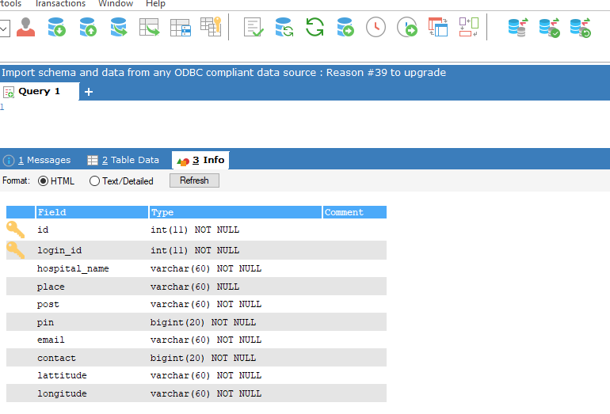
Table Design

Slide 14
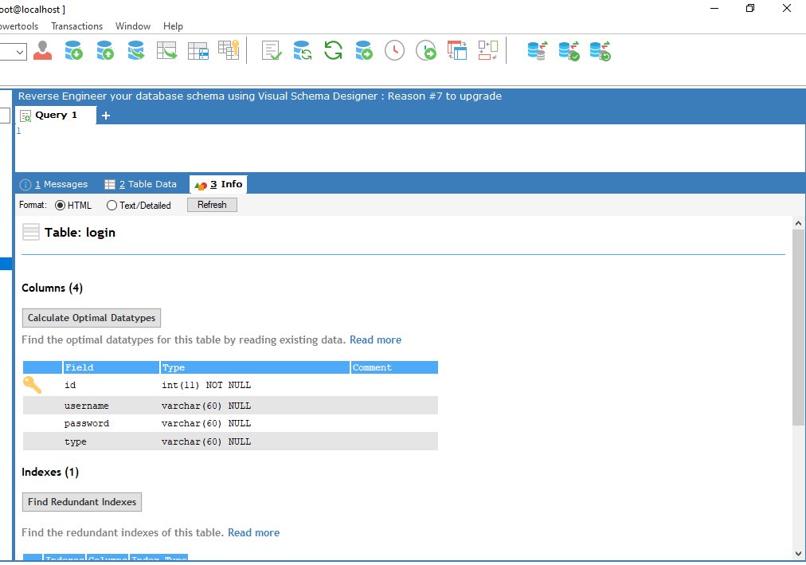

Slide 15
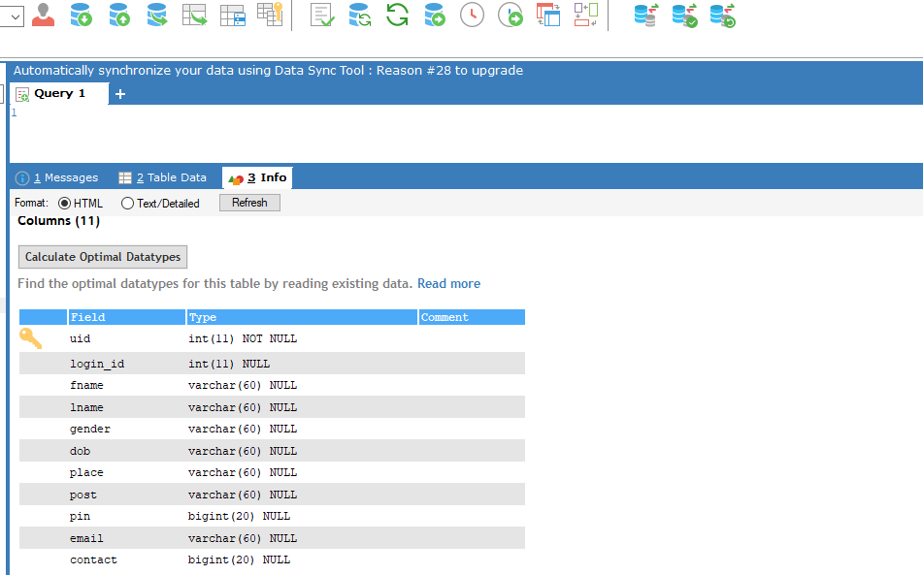

Slide 16
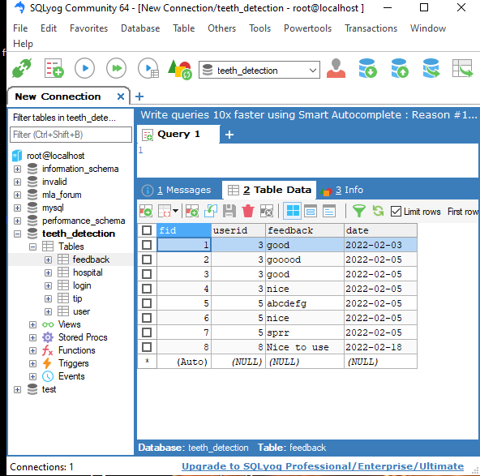

Slide 17
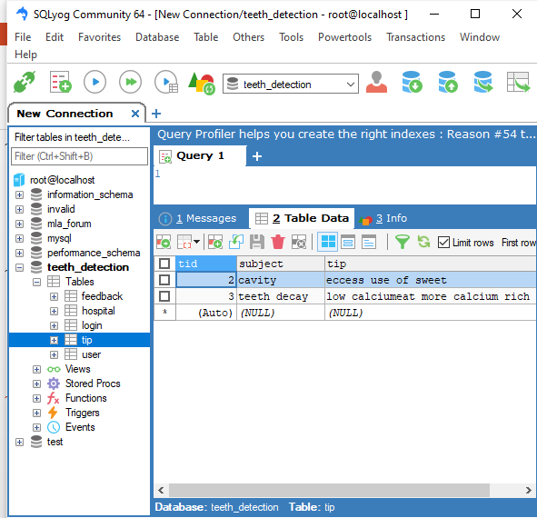

Slide 18
DEVELOPMENT ENVIORNMENT
Software Requirements
OPERATING SYSTEM: WINDOWS 10
FRONT END: HTML, CSS, JAVASCRIPT
BACK END: Mysql
IDE: Jetbrains Pycharm, Android studio
TECHNOLOGY USED: PYTHON,JAVA
FRAME WORK USED: Flask

Slide 19
Future Enhancement
In future Iam trying improve the proposed system by predicting the specific problem on teeth .
Trying to solve particular problem and reduce the chance of any teeth damage ,helping patients to take proper treatments in proper interval of time.
Include more dental hospitals and provide opportunity to consult
Doctors according to feedbacks from other patients
Include a module for doctor ,to help user to interact with doctor

Slide 20
USER STORIES
UserStoryID | As a <type of user> | I want to | So that I can
1 | Admin | login | login successful with correct username and password
2 | Admin | Manage hospitals | Add,view,edit&delete hospitals
3 | Admin | View users | View all registered users
4 | Admin | Add tips | Add tips to help users
5 | Admin | View feedback | View feedback about doctor from users
6 | User | Login | login successful with correct username and password
7 | User | View tips | View all tips from admin
8 | User | Feedback | Provide feedback to admin
9 | User | Upload image | uploads the image and views the result
10 | User | View nearest Hospital | Views nearest hospital for consulting doctor

Slide 21
PROJECT PLAN
User Story ID | Task Name | Start Date | End Date | Days | Status
1 | Sprint 1 | 26/12/2021 | 28/12/2021 | 2 | Completed
2 |  | 29/12/2021 | 31/12/2021 | 3 | Completed
3 |  | 03/12/2021 | 08/01/2022 | 5 | Completed
4 | Sprint 2 | 09/01/2022 | 16/01/2022 | 8 | Completed
5 |  | 18/01/2022 | 22/01/2022 | 5 | Completed
6 | Sprint 3 | 23/01/2022 | 27/01/2022 | 5 | Completed
7 |  | 30/01/2022 | 05/02/2022 | 7 | Completed
8 | Sprint 4 | 06/02/2022 | 10/02/2022 | 5 | Completed
9 |  | 16/02/2022 | 20/02/2022 | 4 | Completed

Slide 22
PRODUCT BACKLOG
User Story ID | Priority <High/Medium/Low> | Size (Hours) | Sprint <#> | Status <Planned/In progress/Completed> | Release Date | Release Goal
1 | Medium | 2 | 1 | Completed |  | Table design
2 | High | 3 |  | Completed |  | Form design
3 | High | 5 |  | Completed |  | Basic coding
3 | Medium | 5 | 2 | Completed |  | Creation of dataset
4 | High | 5 |  | Completed |  | Pre-processing x-ray images
5 | High | 5 | 3 | Completed |  | prediction
6 | high | 5 |  | Completed |  | User prediction process.
7 | Medium | 5 | 4 | Completed |  | Testing data
8 | High | 5 |  | Completed |  | Output generation

Slide 23
SPRINT BACKLOG PLAN
Backlog Item | Status & completion date | Original estimate in hours | Day1 | Day2 | Day3 | Day4 | Day5 | Day6 | Day7 | Day8 | Day9 | Day10 | Day11 | Day12 | Day13 | Day14
User story #1,#2,#3,#4 |  | hrs | Hrs | hrs | hrs | hrs | hrs | hrs | hrs | hrs | hrs | hrs | hrs | hrs | hrs | hrs
Table design | 28/12/2021 | 2 | 1 | 1 | 0 | 0 | 0 | 0 | 0 | 0 | 0 | 0 | 0 | 0 | 0 | 0
Form design | 31/12/2021 | 3 | 0 |  | 1 | 1 | 1 | 0 | 0 | 0 | 0 | 0 | 0 | 0 | 0 | 0
Coding | 08/01/2021 | 5 | 0 | 0 | 0 | 0 | 0 | 1 | 1 | 1 | 1 | 1 | 0 | 0 | 0 | 0
User story #5,#6,#7,#8
Creation of dataset | 16/01/2022 | 5 | 1 | 1 | 0 | 1 | 1 | 1 | 0 | 1 | 0 | 0 | 0 | 0 | 0 | 0
Pre-processing x-ray images | 22/01/2022 | 5 | 0 | 0 | 0 | 0 | 0 | 0 | 0 | 1 | 1 | 0 | 1 | 1 | 1 | 0
prediction | 27/01/2022 | 5 | 1 | 1 | 1 | 0 | 1 | 1 | 0 | 0 | 0 | 0 | 0 | 0 | 0 | 0
User prediction process | 05/02/2022 | 5 | 0 | 0 | 0 | 0 | 0 | 0 | 0 | 1 | 1 | 1 | 1 | 1 | 0 | 0
Testing data | 10/01/2022 | 5 | 1 | 1 | 1 | 1 | 1 | 0 | 0 | 0 | 0 | 0 | 0 | 0 | 0 | 0
User story #9
Output generation | 20/02/2022 | 5 | 0 | 0 | 0 | 0 | 0 | 0 | 2 | 2 | 2 | 0 | 0 | 0 | 0 | 0
Total l |  | 40 | 4 | 4 | 3 | 3 | 4 | 3 | 3 | 5 | 4 | 2 | 2 | 2 | 1 | 0

Slide 24
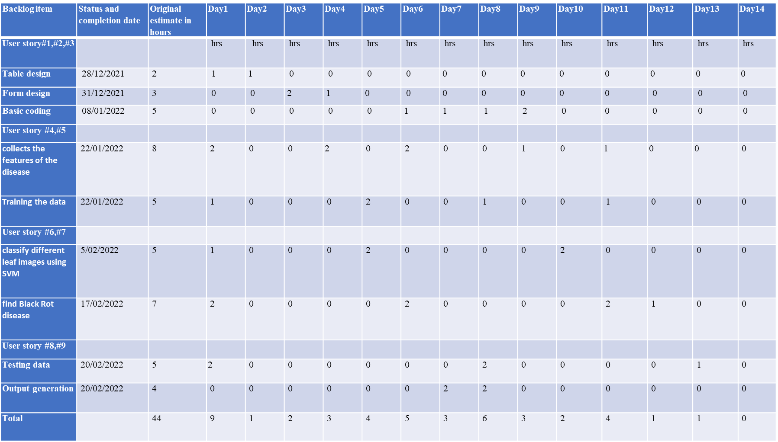
SPRINT ACTUAL
Backlog item | Status and completion date | Original estimate in hours | Day1 | Day2 | Day3 | Day4 | Day5 | Day6 | Day7 | Day8 | Day9 | Day10 | Day11 | Day12 | Day13 | Day14
User story#1,#2,#3 |  |  | hrs | hrs | hrs | hrs | hrs | hrs | hrs | hrs | hrs | hrs | hrs | hrs | hrs | hrs
Table design | 28/12/2021 | 2 | 1 | 1 | 0 | 0 | 0 | 0 | 0 | 0 | 0 | 0 | 0 | 0 | 0 | 0
Form design | 31/12/2021 | 3 | 0 | 0 | 2 | 1 | 0 | 0 | 0 | 0 | 0 | 0 | 0 | 0 | 0 | 0
Basic coding | 08/01/2022 | 5 | 0 | 0 | 0 | 0 | 0 | 1 | 1 | 1 | 2 | 0 | 0 | 0 | 0 | 0
User story #4,#5
collects the features of the disease | 22/01/2022 | 8 | 2 | 0 | 0 | 2 | 0 | 2 | 0 | 0 | 1 | 0 | 1 | 0 | 0 | 0
Training the data | 22/01/2022 | 5 | 1 | 0 | 0 | 0 | 2 | 0 | 0 | 1 | 0 | 0 | 1 | 0 | 0 | 0
User story #6,#7
classify different images using CNN | 5/02/2022 | 5 | 1 | 0 | 0 | 0 | 2 | 0 | 0 | 0 | 0 | 2 | 0 | 0 | 0 | 0
find issue or not | 17/02/2022 | 7 | 2 | 0 | 0 | 0 | 0 | 2 | 0 | 0 | 0 | 0 | 2 | 1 | 0 | 0
User story #8,#9
Testing data | 20/02/2022 | 5 | 2 | 0 | 0 | 0 | 0 | 0 | 0 | 2 | 0 | 0 | 0 | 0 | 1 | 0
Output generation | 20/02/2022 | 4 | 0 | 0 | 0 | 0 | 0 | 0 | 2 | 2 | 0 | 0 | 0 | 0 | 0 | 0
Total |  | 44 | 9 | 1 | 2 | 3 | 4 | 5 | 3 | 6 | 3 | 2 | 4 | 1 | 1 | 0

Slide 25
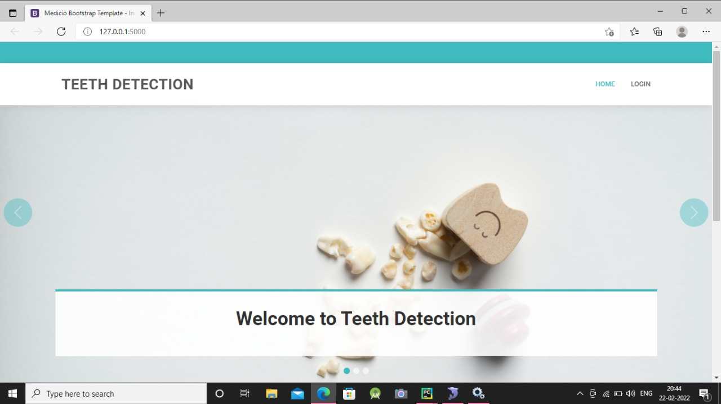
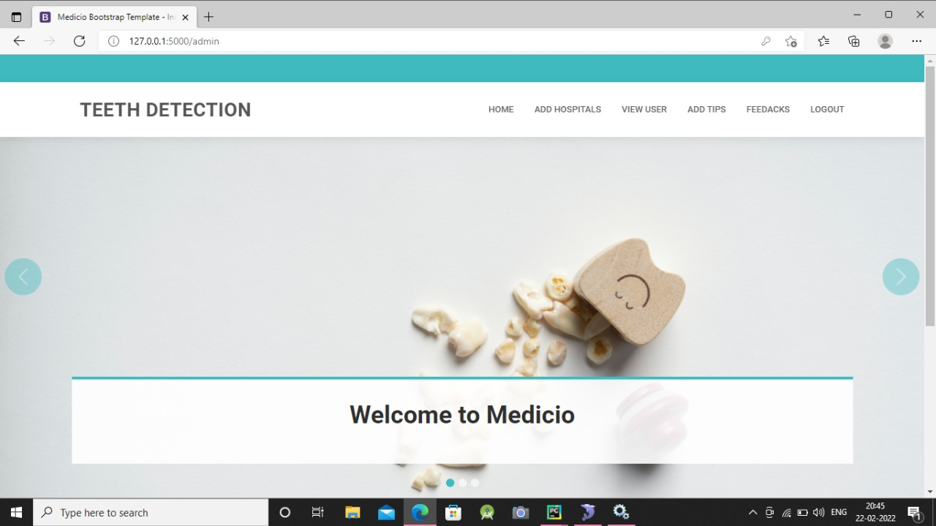
Screenshots

Slide 26
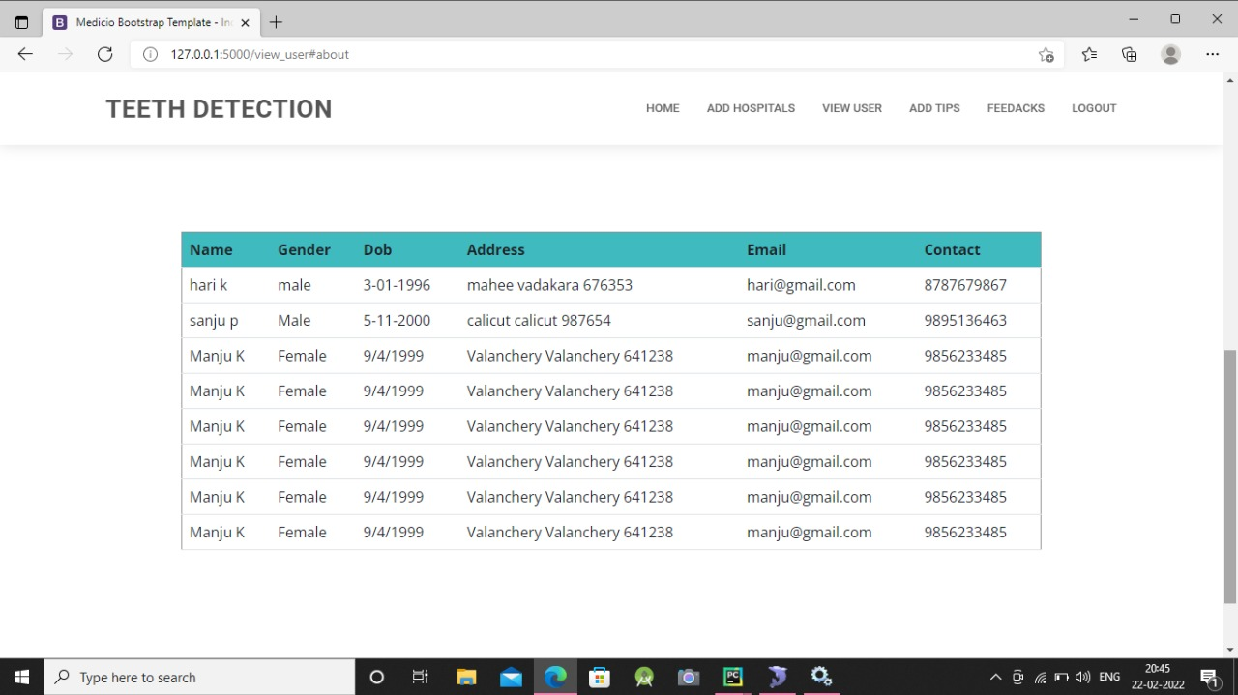
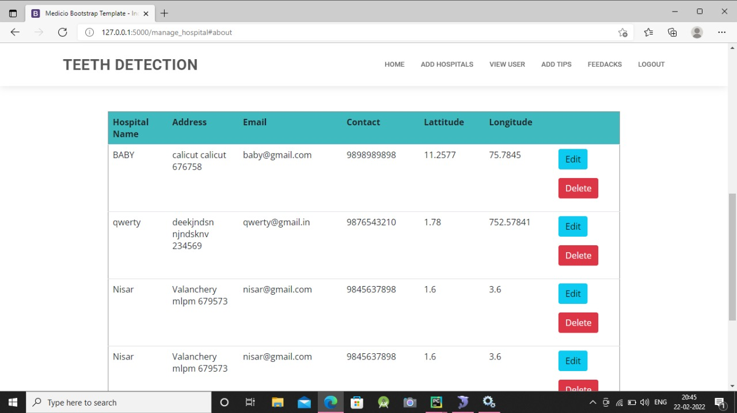

Slide 27
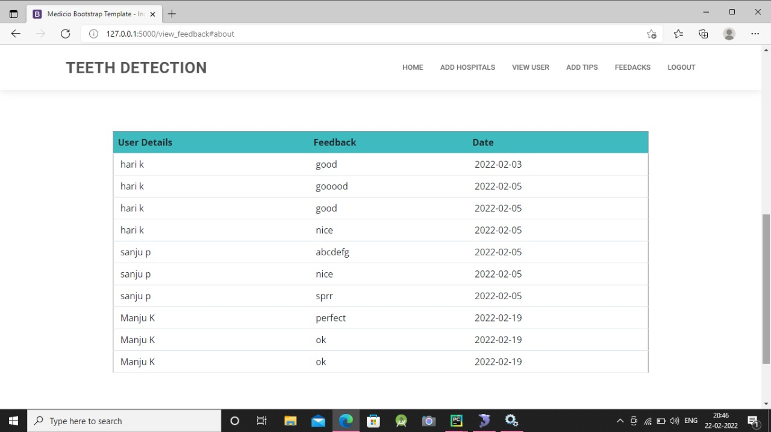
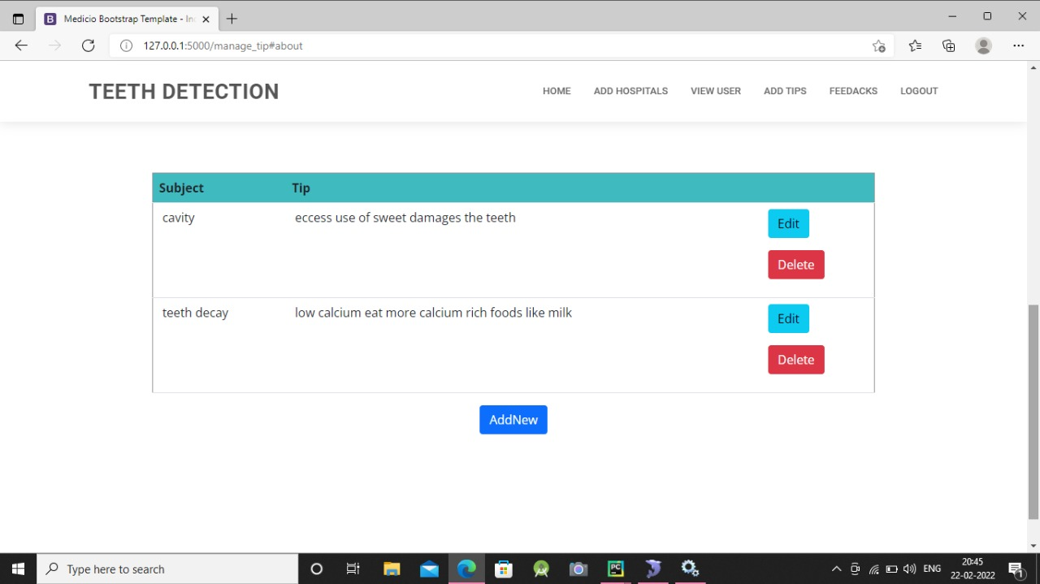

Slide 28
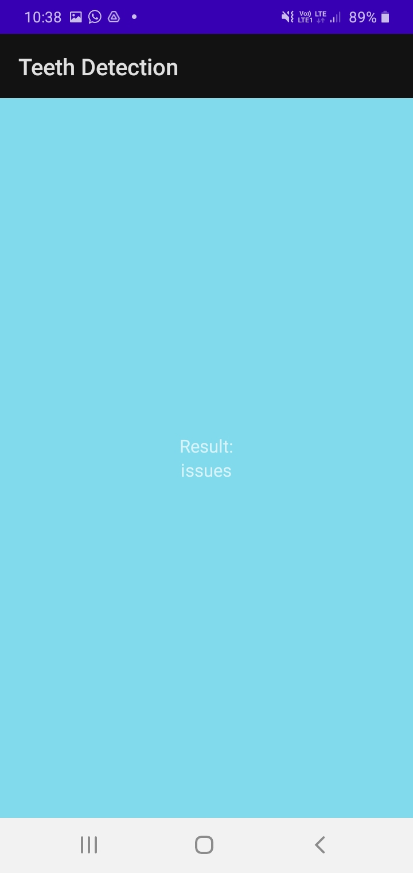
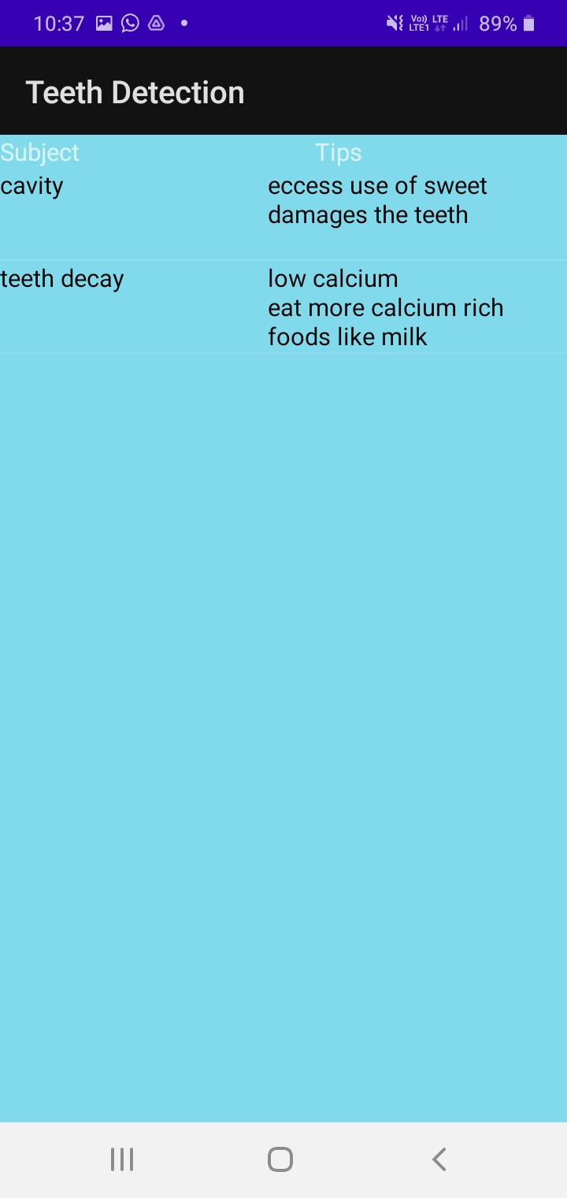
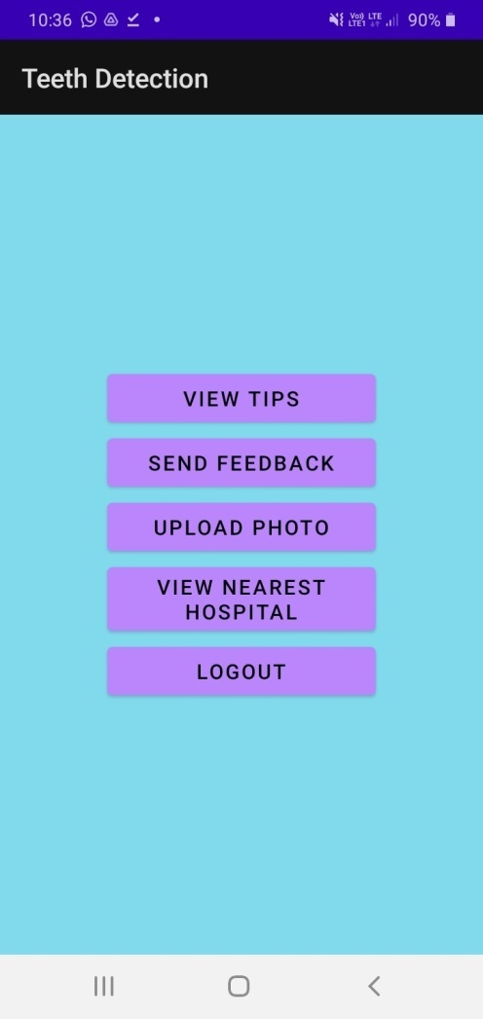

Slide 29
THANK YOU

